Slide 1
Mode Analytics Case Study 1: User Engagement

Slide 2
Problem Statement
Examine the cause of the drop in user engagement for Yammer customer base

Slide 3
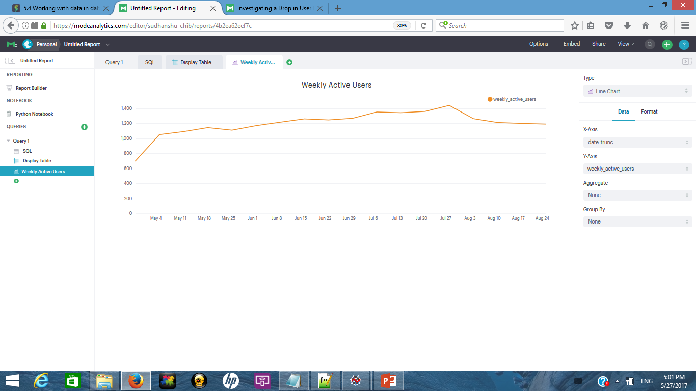
Solution Steps: Step 1: Examining User Engagement
SQL Query:
--SQL code to identify active users over a period of time
SELECT DATE_TRUNC('week', e.occurred_at),
COUNT(DISTINCT e.user_id) AS weekly_active_users
FROM tutorial.yammer_events e
WHERE e.event_type = 'engagement'
GROUP BY 1
ORDER BY 1
Drop in Engagement

Slide 4
Step 2: Customers are of two types: Existing and New Identifying pattern of acquiring new customers over time
--SQL code to identify number of new customers acquired by Yammer each week
select sub.customerage, count(sub.customerage)
from(
select *,
case when extract('day' from '2014-09-01' ::TIMESTAMP - activated_at) <= 7 then '1 week'
when extract('day' from '2014-09-01' ::TIMESTAMP - activated_at) > 7 and extract('day' from '2014-09-01' ::TIMESTAMP - activated_at) <= 14 then '2 week'
when extract('day' from '2014-09-01' ::TIMESTAMP - activated_at) > 14 and extract('day' from '2014-09-01' ::TIMESTAMP - activated_at) <= 21 then '3 week'
when extract('day' from '2014-09-01' ::TIMESTAMP - activated_at) > 21 and extract('day' from '2014-09-01' ::TIMESTAMP - activated_at) <= 28 then '4 week'
when extract('day' from '2014-09-01' ::TIMESTAMP - activated_at) > 28 and extract('day' from '2014-09-01' ::TIMESTAMP - activated_at) <= 35 then '5 week'
when extract('day' from '2014-09-01' ::TIMESTAMP - activated_at) > 35 and extract('day' from '2014-09-01' ::TIMESTAMP - activated_at) <= 42 then '6 week'
when extract('day' from '2014-09-01' ::TIMESTAMP - activated_at) > 42 and extract('day' from '2014-09-01' ::TIMESTAMP - activated_at) <= 49 then '7 week'
when extract('day' from '2014-09-01' ::TIMESTAMP - activated_at) > 49 and extract('day' from '2014-09-01' ::TIMESTAMP - activated_at) <= 56 then '8 week'
when extract('day' from '2014-09-01' ::TIMESTAMP - activated_at) > 56 and extract('day' from '2014-09-01' ::TIMESTAMP - activated_at) <= 63 then '9 week'
when extract('day' from '2014-09-01' ::TIMESTAMP - activated_at) > 63 and extract('day' from '2014-09-01' ::TIMESTAMP - activated_at) <= 70 then '10 week'
when extract('day' from '2014-09-01' ::TIMESTAMP - activated_at) > 70 and extract('day' from '2014-09-01' ::TIMESTAMP - activated_at) <= 77 then '11 week'
when extract('day' from '2014-09-01' ::TIMESTAMP - activated_at) > 77 and extract('day' from '2014-09-01' ::TIMESTAMP - activated_at) <= 84 then '12 week'
when extract('day' from '2014-09-01' ::TIMESTAMP - activated_at) > 84 and extract('day' from '2014-09-01' ::TIMESTAMP - activated_at) <= 91 then '13 week'
when extract('day' from '2014-09-01' ::TIMESTAMP - activated_at) > 91 and extract('day' from '2014-09-01' ::TIMESTAMP - activated_at) <= 98 then '14 week'
when extract('day' from '2014-09-01' ::TIMESTAMP - activated_at) > 98 and extract('day' from '2014-09-01' ::TIMESTAMP - activated_at) <= 105 then '15 week'
when extract('day' from '2014-09-01' ::TIMESTAMP - activated_at) > 105 and extract('day' from '2014-09-01' ::TIMESTAMP - activated_at) <= 112 then '16 week'
else 'longterm'
end as "customerage"
from tutorial.yammer_users
where activated_at is not null
) sub
where sub.customerage <> 'longterm'
group by 1
order by 1

Slide 5
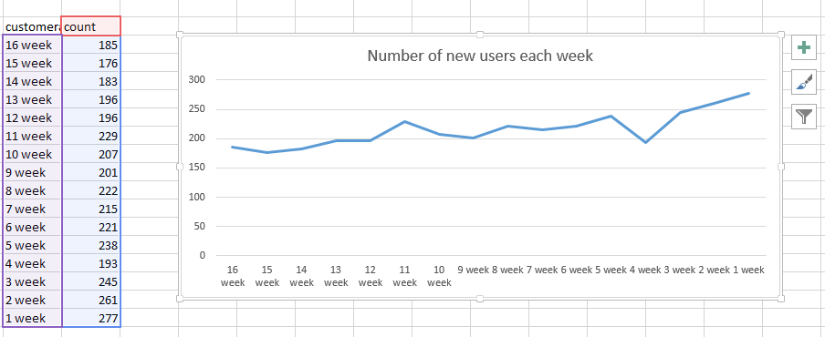
Step 2: Output
Dip in new users

Slide 6
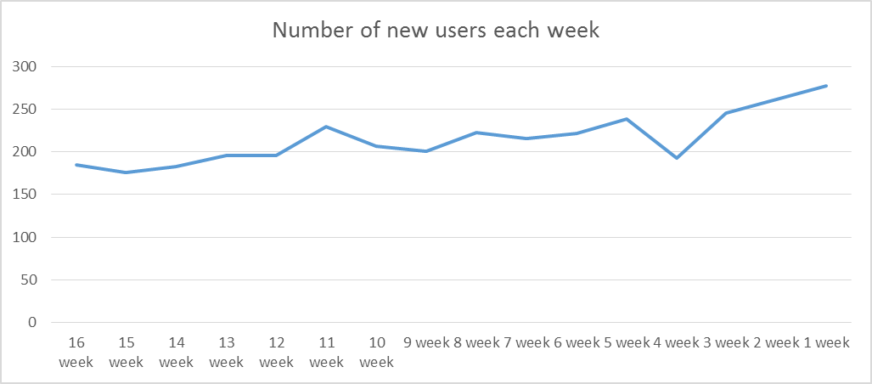
Step 3: Validating impact of new user dip on engagement
Drop in number of new users seems to have a correlation with drop in engagement scores

Slide 7
Step 4: Evaluating engagement of customers over their lifetime by dividing them into cohorts
Link to query
Entire query also pasted in notes below
Notes:
--SQL Query
select sub.week,
sum( case when sub.customer_age='1week' then sub.engagescore else null end) as "1week",
sum( case when sub.customer_age='2week' then sub.engagescore else null end) as "2week",
sum( case when sub.customer_age='3week' then sub.engagescore else null end) as "3week",
sum( case when sub.customer_age='4week' then sub.engagescore else null end) as "4week",
sum( case when sub.customer_age='5week' then sub.engagescore else null end) as "5week",
sum( case when sub.customer_age='6week' then sub.engagescore else null end) as "6week",
sum( case when sub.customer_age='7week' then sub.engagescore else null end) as "7week",
sum( case when sub.customer_age='8week' then sub.engagescore else null end) as "8week",
sum( case when sub.customer_age='9week' then sub.engagescore else null end) as "9week",
sum( case when sub.customer_age='10week' then sub.engagescore else null end) as "10week",
sum( case when sub.customer_age='11week' then sub.engagescore else null end) as "11week",
sum( case when sub.customer_age='12week' then sub.engagescore else null end) as "12week",
sum( case when sub.customer_age='13week' then sub.engagescore else null end) as "13week",
sum( case when sub.customer_age='14week' then sub.engagescore else null end) as "14week",
sum( case when sub.customer_age='15week' then sub.engagescore else null end) as "15week",
sum( case when sub.customer_age='16week' then sub.engagescore else null end) as "16week",
sum( case when sub.customer_age='longterm' then sub.engagescore else null end) as "longterm"
from(
select DATE_TRUNC('week', e.occurred_at) as "week" ,u.customer_age, count(distinct e.user_id) as "engagescore"
from tutorial.yammer_events e
join (
select *,
case when extract('day' from '2014-09-01' ::TIMESTAMP - activated_at) <= 7 then '1week'
when extract('day' from '2014-09-01' ::TIMESTAMP - activated_at) > 7 and extract('day' from '2014-09-01' ::TIMESTAMP - activated_at) <= 14 then '2week'
when extract('day' from '2014-09-01' ::TIMESTAMP - activated_at) > 14 and extract('day' from '2014-09-01' ::TIMESTAMP - activated_at) <= 21 then '3week'
when extract('day' from '2014-09-01' ::TIMESTAMP - activated_at) > 21 and extract('day' from '2014-09-01' ::TIMESTAMP - activated_at) <= 28 then '4week'
when extract('day' from '2014-09-01' ::TIMESTAMP - activated_at) > 28 and extract('day' from '2014-09-01' ::TIMESTAMP - activated_at) <= 35 then '5week'
when extract('day' from '2014-09-01' ::TIMESTAMP - activated_at) > 35 and extract('day' from '2014-09-01' ::TIMESTAMP - activated_at) <= 42 then '6week'
when extract('day' from '2014-09-01' ::TIMESTAMP - activated_at) > 42 and extract('day' from '2014-09-01' ::TIMESTAMP - activated_at) <= 49 then '7week'
when extract('day' from '2014-09-01' ::TIMESTAMP - activated_at) > 49 and extract('day' from '2014-09-01' ::TIMESTAMP - activated_at) <= 56 then '8week'
when extract('day' from '2014-09-01' ::TIMESTAMP - activated_at) > 56 and extract('day' from '2014-09-01' ::TIMESTAMP - activated_at) <= 63 then '9week'
when extract('day' from '2014-09-01' ::TIMESTAMP - activated_at) > 63 and extract('day' from '2014-09-01' ::TIMESTAMP - activated_at) <= 70 then '10week'
when extract('day' from '2014-09-01' ::TIMESTAMP - activated_at) > 70 and extract('day' from '2014-09-01' ::TIMESTAMP - activated_at) <= 77 then '11week'
when extract('day' from '2014-09-01' ::TIMESTAMP - activated_at) > 77 and extract('day' from '2014-09-01' ::TIMESTAMP - activated_at) <= 84 then '12week'
when extract('day' from '2014-09-01' ::TIMESTAMP - activated_at) > 84 and extract('day' from '2014-09-01' ::TIMESTAMP - activated_at) <= 91 then '13week'
when extract('day' from '2014-09-01' ::TIMESTAMP - activated_at) > 91 and extract('day' from '2014-09-01' ::TIMESTAMP - activated_at) <= 98 then '14week'
when extract('day' from '2014-09-01' ::TIMESTAMP - activated_at) > 98 and extract('day' from '2014-09-01' ::TIMESTAMP - activated_at) <= 105 then '15week'
when extract('day' from '2014-09-01' ::TIMESTAMP - activated_at) > 105 and extract('day' from '2014-09-01' ::TIMESTAMP - activated_at) <= 112 then '16week'
else 'longterm'
end as "customer_age"
from tutorial.yammer_users
where activated_at is not null
) u
on e.user_id=u.user_id
where e.event_name='login'
group by 1,2
) sub
group by 1

Slide 8
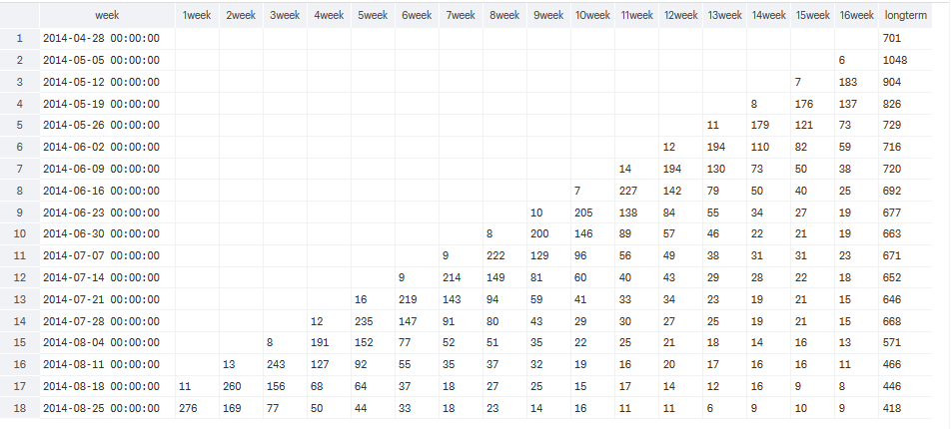
Step 4: Output (1/2)

Slide 9
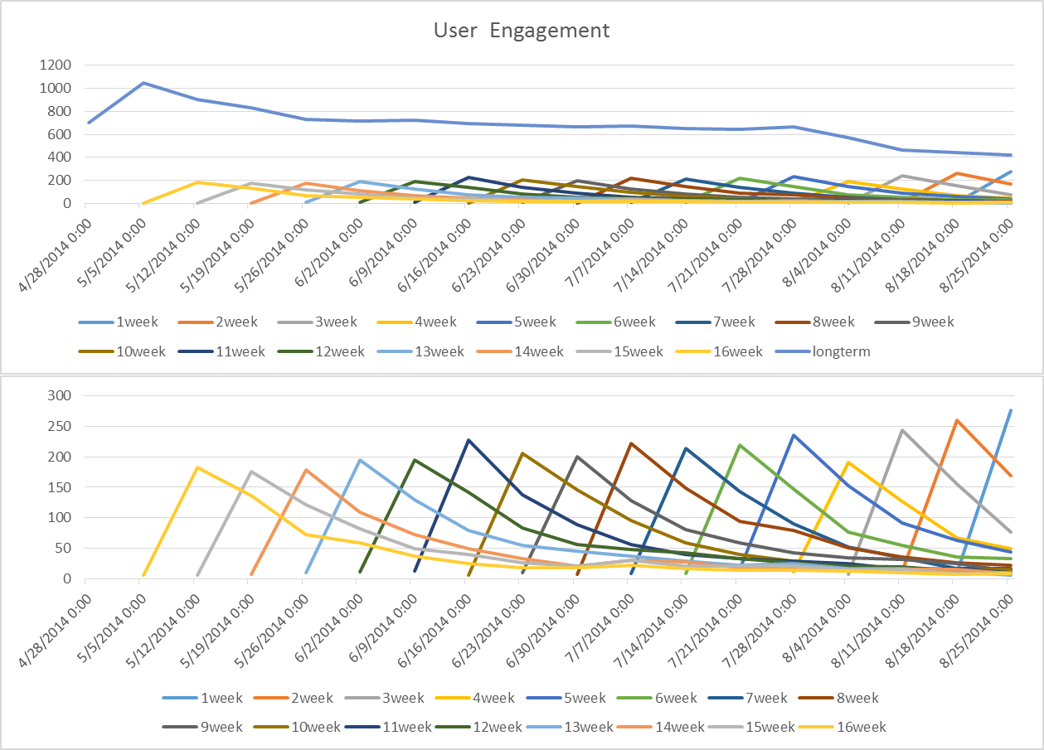
Step 4: Output (2/2)
When a user starts using Yammer their engagement is high and then progressively decreases with time

Slide 10
Insights and Recommendation:
Yammer as a product seems to have a problem of keeping user engaged over a period of time
New users tend to use it frequently but their use of the application decreases as time goes on
The current dip in engagement is attributed to two causes:
Over all downward trend of engagement of existing users
A dip in acquisition of new users (that tend to boost engagement at aggregate level)
Recommendation:
Incentivise use of Yammer application for existing users to arrest long term engagement decline
For the short term, push hard for customer acquisition as the new users drive engagement

